Slide 1
Finding Your Way Through Beacons
Scott Heckel

Slide 2

Scott Heckel
MSSE 2011
scott.heckel@gmail.com
@scottheckel
Consultant @

Slide 3
What are Beacons?

Slide 4
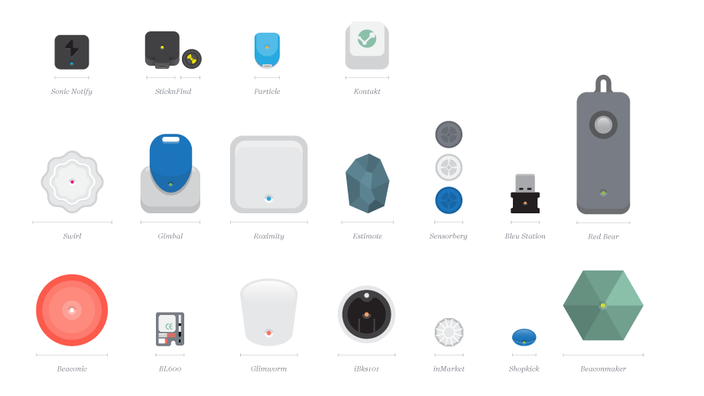
Bluetooth LE Proximity Sensors
Notes:
Range of up to 100 meters
iBeacon Standardized by Apple @ WDC 2013

Slide 5
They Emit an Identifier
UUID
Major Number
Minor Number
Company Identifier
Section Identifier
Part Identifier

Slide 6
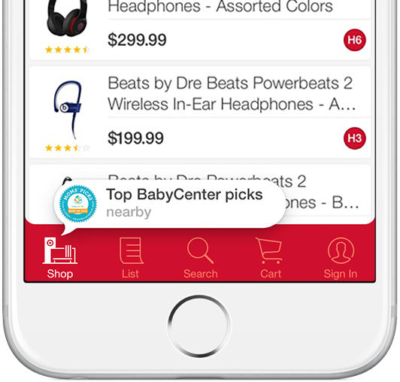
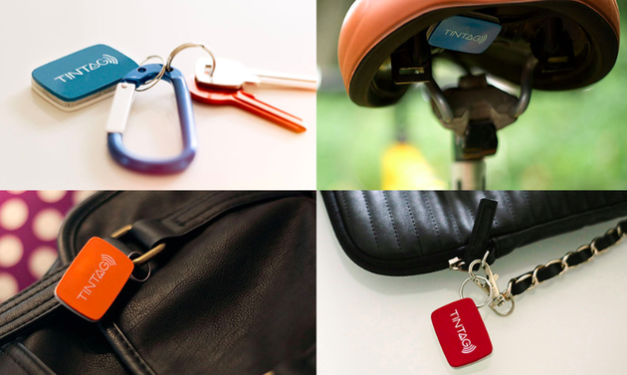
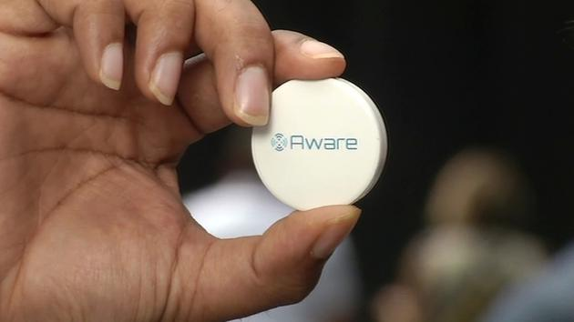
Proximity Notifications
Notes:
Uses
Marketing
Tracking
Payments – PayPal Beacons
Close Range – Know the strength of the signal
Immediate – 0-2 meters
Near – 2-10 meters
Far 10+ meters
Can do different actions at different ranges
Item tracker alerts you when you’re far from your keys
Museum might tell you about the particular piece you’re looking at near range
Login or authorization at immediate range (replace nfc?)

Slide 7


Wayfinding - Micro-level GPS
Notes:
GPS – “worst case” pseudorange of 7.8 meters w/ 95% confidence
Beacons within feet

Slide 8
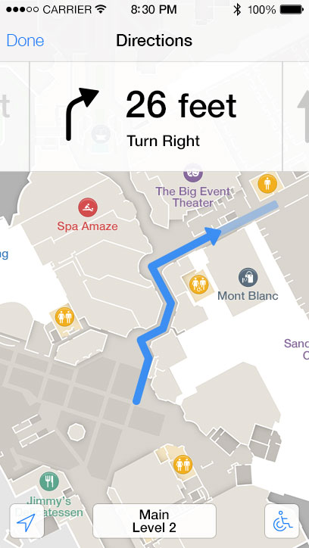
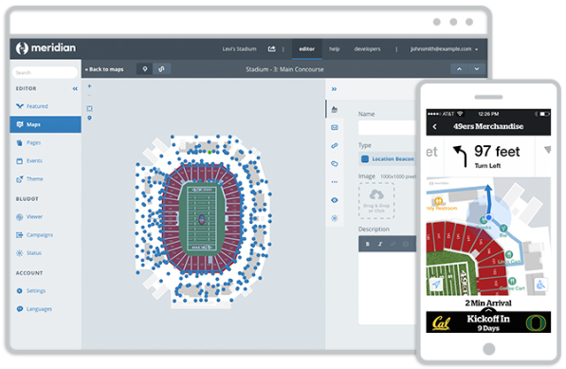
Wayfinding – Micro-level GPS
Notes:
Combine three beacons to triangulate your location
Meridian App – Aruba Beacons
Navigation
Bluedot
Campaigns / Fences

Slide 9

What does the Future hold?
Notes:
Some ideas?
Walk into starbucks and you can auto-order your regular… skip the line and walk up to pickup
Car has a beacon… it’s now your parking pass
etc

Slide 10
Disadvantages
Cost in Volume Capacity
Short Battery Life
Low Range
Bluetooth must be Enabled
Notes:
Short Battery Life
In practice… Weeks or Months… at best a year
Low Range
Bluetooth range isn’t that far
Will need a lot of these

Slide 11
Competition
Wireless / Cisco Mobility Services Engine
RFID / NFC

Slide 12
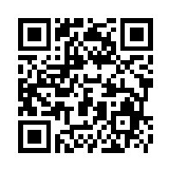
Questions?
scott.heckel@gmail.com
@scottheckel
https://www.github.com/scottheckel/talks

